Slide 1
Microcomputer Principles
&
Computer Interface
Lu Yin
luyin@nwpu.edu.cn

Slide 2
Chapter 13 8253/54 Timer
Contains
  The internal structure of 8253/54 PIT (programmable interval timer)
  Program the three counters within 8253/54
  Diagram how the PIT is connected in the IBM PC

Slide 3
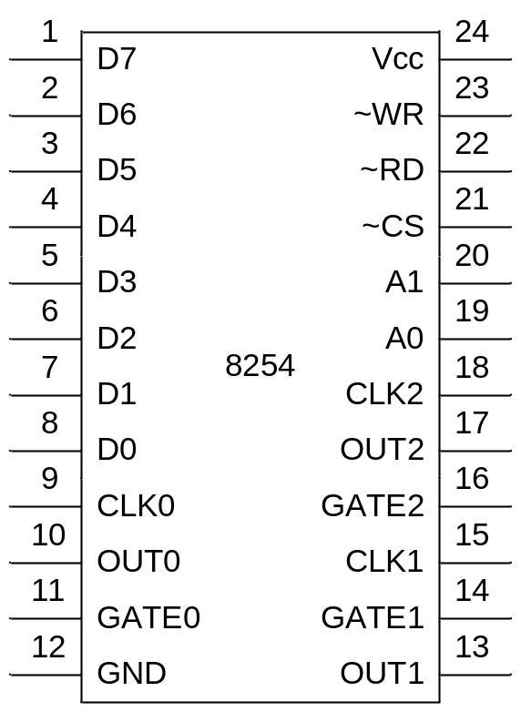
Section 13.1 8253/54 Timer
Function and PIN description
  Provides 3 separated down count timer
  All the timer can be programmed to be working in 6 modes
  Output rate is a quotient of input CLK rate
  PIN definition
    VCC and GND
    D0~D7: data bus
    A0~A1: address bus
    ~CS, ~RD,~WR: control bus
    CLKi: input clock frequency(0~8MHz)
    OUTi: output frequency
    GATEi: counter enable control

Slide 4
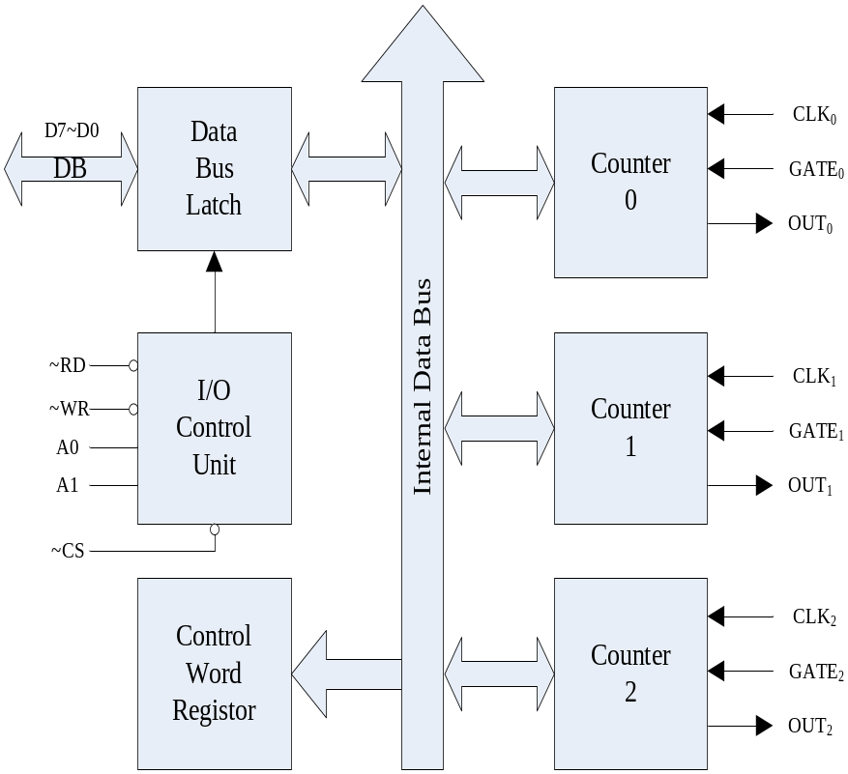
Section 13.1 8253/54 Timer
Internal Structure
  Data Bus Buffer
  IO control unit
  Control word register
  Down count timer 0~2
CS will enable the PIT, and A1 A0 will select ports:
CS A1 A0 selected port
0 0 0 port for Timer0
0 0 1 port for Timer1
0 1 0 port for Timer2
0 1 1 port for ctrl word reg

Slide 5
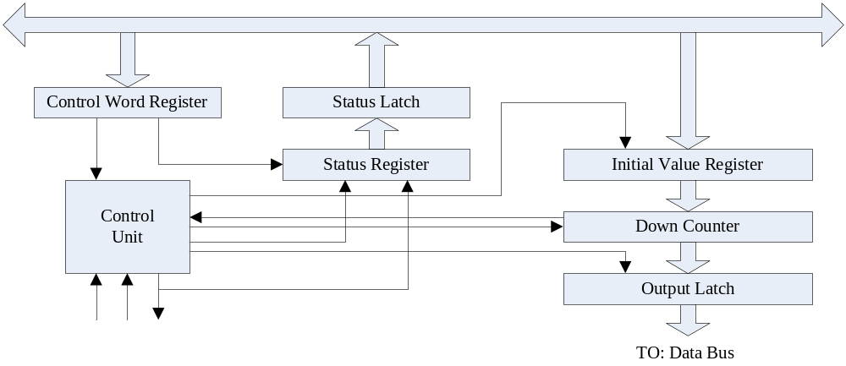
Section 13.1 8253/54 Timer
Internal principles of 8254 timer
  Down counter (16 bits)
  Initial Value Register (division divisor) (16 bits)
  Output latch (16 bits)

Slide 6
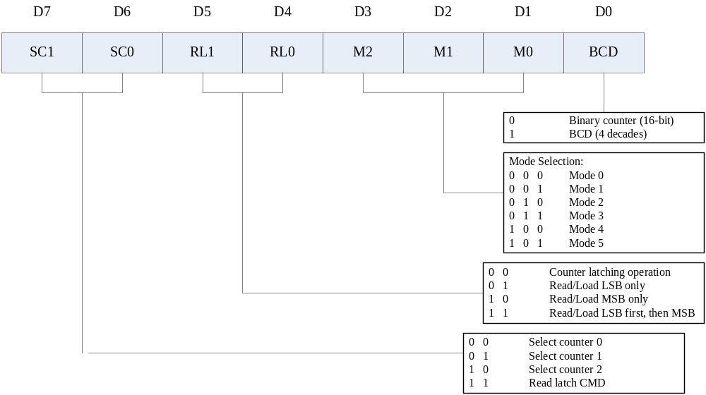
Section 13.1 8253/54 Timer
8254 Control word

Slide 7
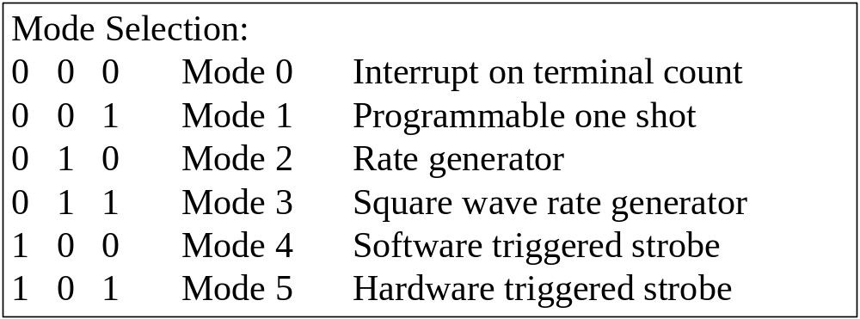
Section 13.1 8253/54 Timer
Working modes

Slide 8
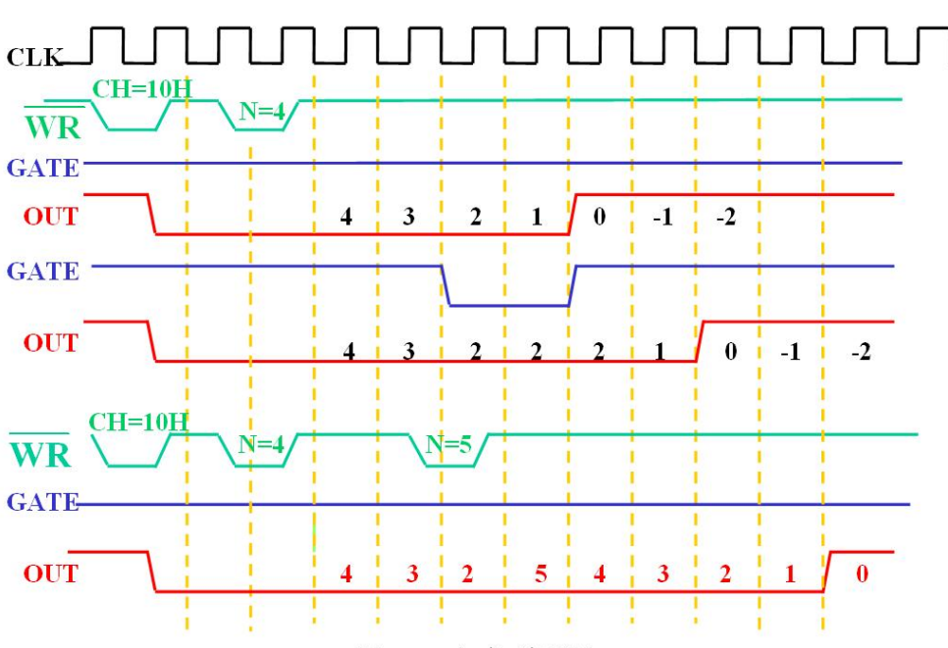
* Especially useful in counting events
8254 working modes
  Mode 0 timing

Slide 9
* Especially useful in counting events
8254 working modes
  Mode 0 timing - Summarize
Characteristic
  Mode 0 will start after initializing;
  Mode 0 will not restart the counter automatically;
  The output is a level signal, low effective, last for the duration of counting;
Utilization
  Signal generation: a low level effective signal last for a short time;
  Pulse signal counting.

Slide 10
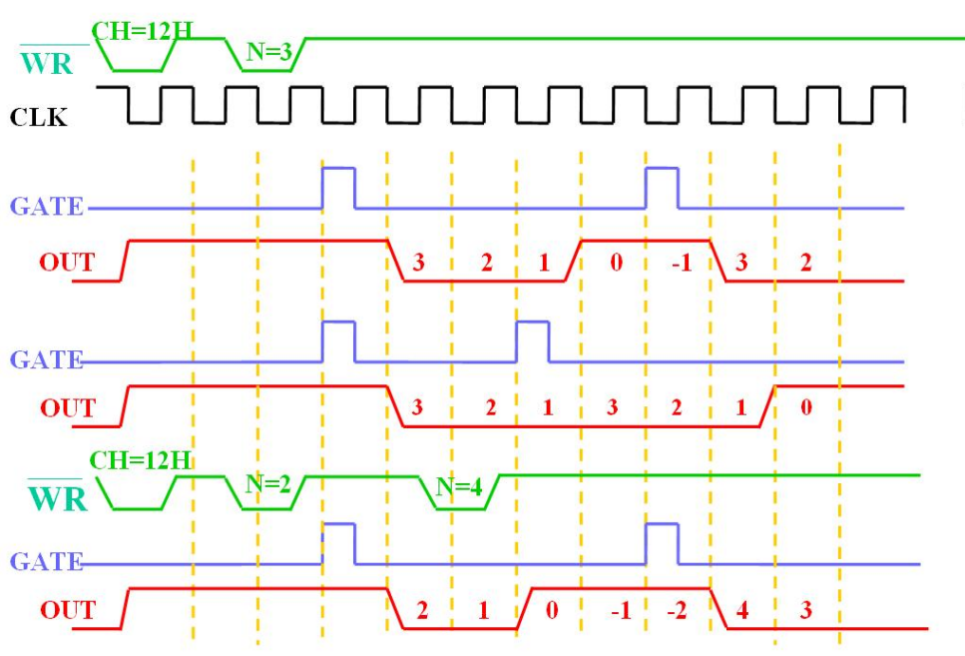
* Implement a mono-stable flip-flop circuit
8254 working modes
  Mode 1 timing

Slide 11
* Especially useful in counting events
8254 working modes
  Mode 1 timing - Summarize
Characteristic
  Mode 1 must be triggered by a pulse of GATE;
  Mode 1 will not restart the counter automatically;
  The output is a level signal, low effective, last for the duration of counting;
Utilization
  Signal generation: a low level effective signal last for a short time;
  Delayed control: automate door control, triggered by GATE

Slide 12
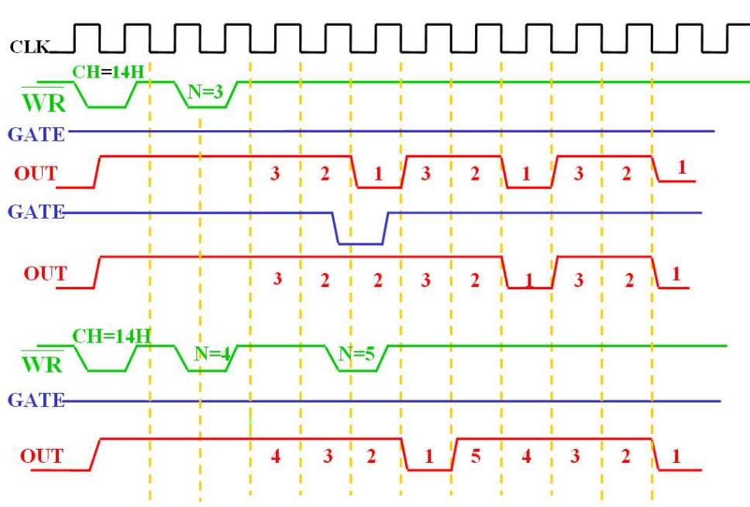
* Implement a frequency generator
8254 working modes
  Mode 2 timing

Slide 13
* Especially useful in counting events
8254 working modes
  Mode 2 timing - Summarize
Characteristic
  Mode 2 will start after initializing;
  Mode 2 WILL restart the counter automatically, and output continuously;
  The output is a continuously pulse wave, low effective, last for only 1 clock cycle;
Utilization
  Signal generation: continuous pulse wave
  Frequency division: output freq. = input freq. / n, n=initial value

Slide 14
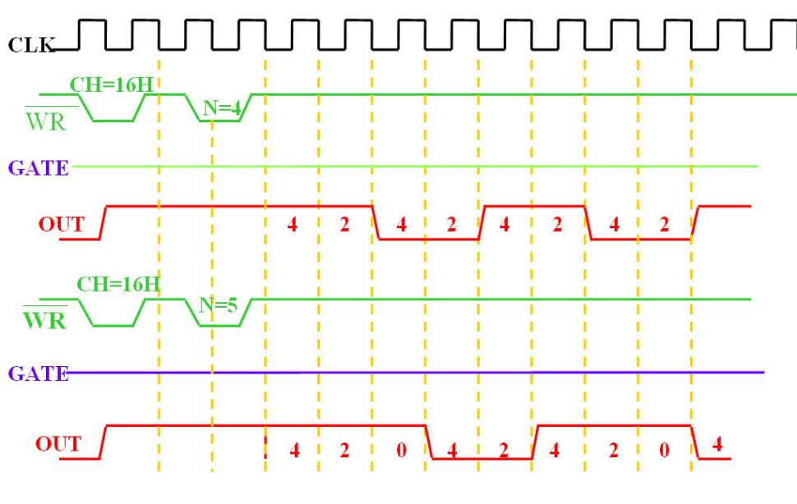
* Implement a squire wave generator
8254 working modes
  Mode 3 timing

Slide 15
* Especially useful in counting events
8254 working modes
  Mode 3 timing - Summarize
Characteristic
  Mode 3 will start after initializing;
  Mode 3 WILL restart the counter automatically, and output continuously;
  The output is a continuously pulse wave, positive half first, last for n clock cycles;
Utilization
  Signal generation: continuous square wave
  Frequency division: output freq. = input freq. / n, n=initial value

Slide 16
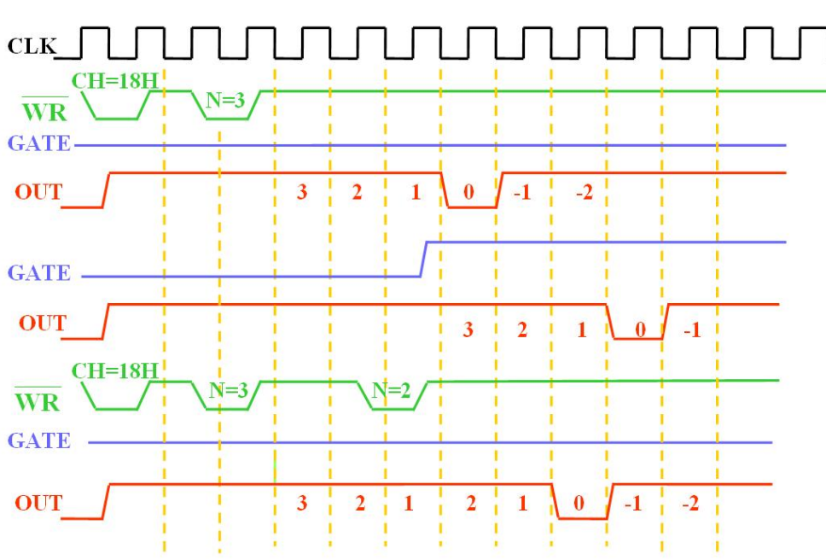
* Especially useful in counting events
8254 working modes
  Mode 4 timing

Slide 17
* Especially useful in counting events
8254 working modes
  Mode 4 timing - Summarize
Characteristic
  Mode 4 will start after initializing;
  Mode 4 will not restart the counter automatically;
  The output is a pulse signal, low effective, last for only one clock cycle;
  Mode 4 is always called as “software triggered output”. It looks like a combination of mode 0 and mode 2 without auto restart.
Utilization
  Pulse signal counting, when pulse output is required.

Slide 18
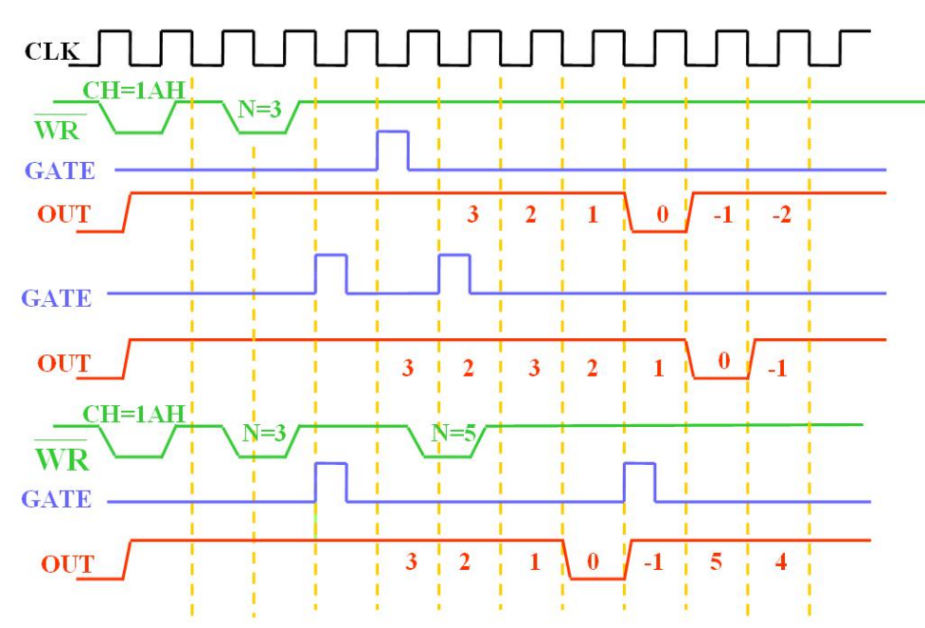
*
8254 working modes
  Mode 5 timing

Slide 19
* Especially useful in counting events
8254 working modes
  Mode 5 timing - Summarizea
Characteristic
  Mode 5 must be triggered by a pulse of GATE;
  Mode 5 will not restart the counter automatically;
  The output is a pulse signal, low effective, last for only one clock cycle;
  Mode 5 is always called as : hardware triggered output. It looks like a combination of mode 1 and mode 2 without auto restart.
Utilization
  Delayed signal generation: a triggered pulse output after n clock cycle;

Slide 20
*
Section 13.1 8253/54 Timer
Steps to program
  Calculate the Initial value (divisor)
  Write the control word
  Enable the down counter
  Wait for output, or
  Write the read latch command to buffer the down counter value
  Read latched counter value
  Restart the timer

Slide 21
Section 13.1 8253/54 Timer
Example 13-1
Pin CS of a given 8253/54 is activated by A7~A2 = 100101.
  (a) Find the port addresses assigned to this 8253/54
  (b) Find the configuration for this 8254 if control register is programmed as :
      MOV AL, 00110110
      OUT 97H, AL
Solution:
  (a) From table 13-1, we have the following:
    CS A1 A0 Port the port address (hex)
    1001 01 0 0 counter0 94
    1001 01 0 1 counter1 95
    1001 01 1 0 counter2 96
    1001 01 1 1 ctrl reg 97
  (b) Breaking down the control word 0011 0110 and compare it with Table 13-1:
    SC = 00 indicates counter 0 is selected
    RL = 11 indicates both the low and high bytes of the initial value reg. will be programmed.
    M = 011 indicates that counter 0 will be set in mode 3
    BCD = 0 indicates that count in binary format

Slide 22
Section 13.1 8253/54 Timer
Example 13-2
Using the port address in example 13-1, show the programming of counter 1 to divide CLK1 by 10,000, producing the mode 3 square wave. Use the BCD option in the control byte.
Solution
  MOV AL, 77H ;counter 1, mode 3, BCD
  OUT 97H, AL ;write control word
  SUB AL, AL ;Al =0 load the division for 10000
  OUT 95H, Al ;send the low byte
  OUT 95H, AL ;then send the high byte
  ;mode 3 will start when initial value is set (suppose GATE2 is high)

Slide 23
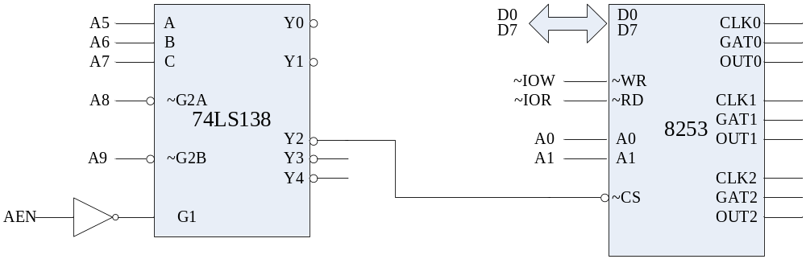
Section 13.2
X86 PC 8254 timer connection and programming
Port address of 8254 Time in IBM PC
Binary Address |  |  | Hex Address | Function
AEN A9 A8 | A7 A6 A5 A4 | A3 A2 A1 A0
1 0 0 | 0 1 0 x | x x 0 0 | 40 | Counter 0
1 0 0 | 0 1 0 x | x x 0 1 | 41 | Counter 1
1 0 0 | 0 1 0 x | x x 1 0 | 42 | Counter 2
1 0 0 | 0 1 0 x | x x 1 1 | 43 | Counter register

Slide 24
Section 13.2
X86 PC 8254 timer connection and programming
Function of three counters (Figure 13-4)
  Counter 0: to IRQ0 of 8259 interrupt controller.
    Counter will generate a watch dog interrupt request
    The interrupt response routine needs to be initialized by user.
  Counter 1: Generate a DRAM refresh request
    The refreshing is down under DMA controller 8237
    And the DRAM will be refreshed every 15us
    A 66278 Hz output₂ is connected to 8237.DREQ1
  Counter 2: is connected with the speaker to generate the beep sound.
    The timer 2 provides the sound wave;
    And PORT 61H. PB1&PB0 controls the GATE2 of timer2
    Gate2 can be used as a switch of the IBM PC speaker
  Time delay for X86 PCs
    Instruction executing time various from CPU speed
    IBM PC use PORT 61H.PB4 to generate a hardware timer: toggle every 15.085 ms

Slide 25
Extra 1:
How do I know the current counter value?
  The current down counter value can be latched and read out through port
  When the Timer is working, the output latch will copy the down counter
  We can write a LATCH CMD WORD to the control register port, in order to hold the output latch for reading
  Follows the LATCH CMD, a RD operation through a Timer Port will read out the latched value
  After the RD operation, the output latch will follow the down counter again.

Slide 26
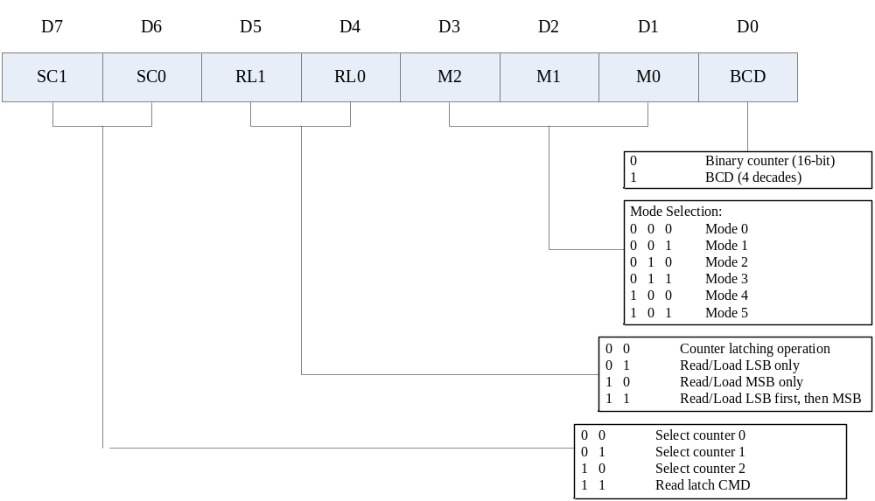
The orgnization of Latch CMD looks like control word:

Slide 27
Using the port address in example 13-1. Count 9999 with Timer0. Wait for a while, and then read out current time.
Solution
  MOV AL, 31 ;counter 0, both bytes, mode 0, BCD
  OUT 97H, AL ;write control word
  MOV AL, 99H ;
  OUT 94H, AL ;send the low byte
  OUT 94H, AL ;then send the high byte
  CALL WaitForAWhile
  OUT 97H, 00H ;counter0, latch, (other bits=0)
  IN AL, 95H

Slide 28
Extra 2. Make use of PIT 8254
1. Triger signal generating:
  generate a contineous pulse signale of given frequency.
    calculate the initial value
    connect 2~3 TIMER unit to build up a cascaded divider circuit

Slide 29
Extra 2-1
A 8254PIT is used in a temperature sampling and adjusting system. It is required that the temperature should be sampled every 30s. A crystal is used to generate the clock, which is 2MHz.
  plz build up the timer circuit.
  plz program the PIT controller.

Slide 30
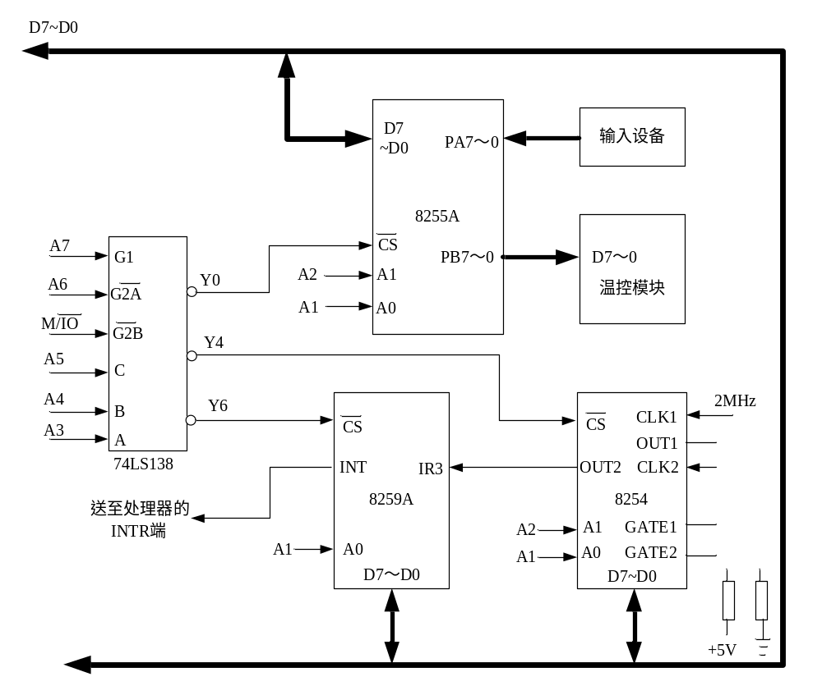

Slide 31
Solution:
  30s = inital value/2M, iniv =60,000,000 >> 65,535
  At least two timer should be in cascaded.
  Timer1 level 1, mode 2, iniv = 10,000
  Timer2 lever 2, mode 2 also, iniv = 6,000

Slide 32
MOV AL, 67H ;8254 Timer1 CMDW
OUT A6H, AL
MOV AL, A5H ;8254 Timer2 CMDW
OUT A6H, AL
MOV AL, 00H ;feed Timer 1 iniv
OUT A2H, AL
MOV AL, 60H ;feed Timer 2 iniv
OUT A4H, AL

Slide 33
Extra 2
2. Gate control signal generating:
  generate a gate signal of a given duration
    calculate the down counter initial value
    plz take care of the margin of error. Increase the input clk frequency to decrease the error.

Slide 34
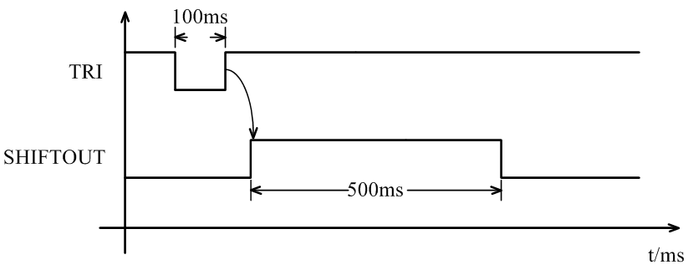
Extra 2-2
Plz generate the SHIFTOUT signal. the error should be limited within 0.1ms. A crystal of 10MHz is used as the clock.

Slide 35
Solution:
  Mode 0 and Mode 1 are both ok
  the GATE shoulde be used to start timer
  a cascaded 2 level timer should be used.
    the first level should generate a clk that full fill error limitation requirements
    the second level should generate the gate and full fill width requirements

Slide 36
Solution:
  Margin of error = 0.1 ms
    a clk of 1/0.00001 = 1MHz should be created
    Timer0 in mode2, iniv = 10M/1M = 1k
  Width of gate = 500 ms
    iniv of level2 timer = 500/0.1 = 5000
    Timer1 in mode0/mode1, iniv = 5000

Slide 37
Extra 2
3. Gate width measurement
  A gate signal is given to be measured. An estimated width is alread known, and a margin of error is given.
    calculate the down counter initial value. The counter timer MUST be greater than the estimated withe plus error limition.
    plz take care of the margin of error. Increase the input clk frequency to decrease the error.

Slide 38
Extra 2-3
Plz measure the width of FIRE(FR) signal. The margin of error should be within 0.1ms. A 10MHz crystal is used as the clock.
FIRE(FR)

Slide 39
Solution:
  Mode 0 should be used.
  the target signal should be used as the GATE control of the timer.
  When the measure is finished, counter value should be read out
  and the with = (initvalue - cntvalue) * Tclk
  a cascaded 2 level timer should be used.
    the first level should generate a clock signal to meat the requirements of margin of errors;
    the second level will be used to measure the gate

Slide 40
Solution:
  Margin of error = 0.1 ms
    a clk of 1/0.00001 = 1MHz should be created
    Timer0 in mode2, iniv = 10M/1M = 1k
  Width of gate = 500 ms
    iniv of level2 timer = 500/0.1 = 5000
    Timer1 in mode0/mode1, iniv = 5000 *n (n>1.2)

Slide 41
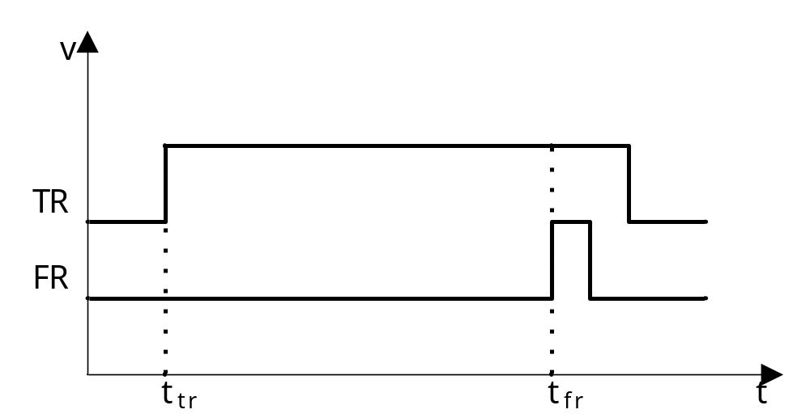
The timing diagram of delayed fire module can be found below：
  If there is a TR(jumping edge) at t_{tr}, then there should be a fire pulse output from FR at t_{fr}
  We define ΔT=t_{fr}-t_{tr}. It is required that ΔT =1±0.1s
Please measure if ΔT is OK.
  A device is developed to have the test of ΔT
  When switch K is closed, the test begins.
  If ΔT is OK, light the green led; if failed, light the red one.
  Prepare the initialization program and interrupt procedure for the device.

Slide 42
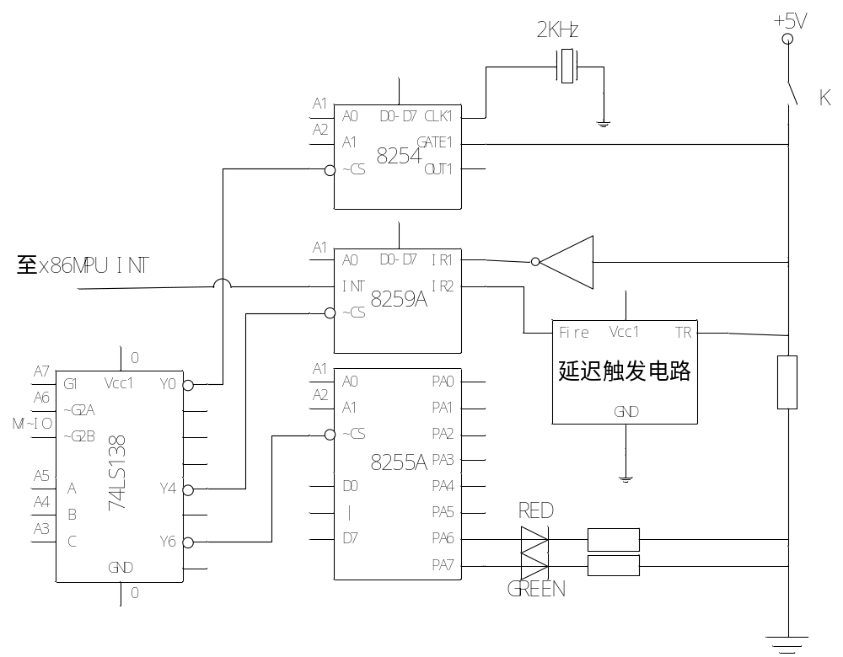

Slide 43
Solution:
  When K is closed, GATE is available, and the down counting process will begin. Thus Mode 0 could be used.
  When the module outputs fire signal, it will trigger an interrupt. Inside the interrupt service routine procedure, we can read back the counting value, and make the judgement of ΔT.
  Then, when switch is open, an other jumping edge will trigger interrupt at IR1. Inside the service routine, we should initialize the 8254 timer again.
  Also a cascaded 2 level timer should be used.
    the first level should generate a clock signal to meat the requirements of margin of errors;
    the second level will be used to measure the gate

